Slide 1
Finance Dept:
Cost Control proposal
System implementation - ERP
planning, budgeting, Communication (Integration) & control

Slide 2
Index
Introduction
System Implementation Overview – ERP
Accurate Business Portfolio Report
Why Business Analyzing
Roadmap
Goals
  Cost Control – Financial Prospective
  Quality Control – Customers Prospective
  Documentation – Internal Processes
  Learning & Growth
  Project Lifecycle
  Activity Time Schedule (WBS)
  Project Cost Structure Standardization
  Product Lifecycle (Route)
  Activity Based Cost Analyzing - ABC (Cost Driver)
  Product (Industrial) Cost Structure Standardization
  Project Sales/Cost Estimation Budget Before Contract
  Project/Product (Industrial) Budgeting Based on WBS & ABC
  Outsourcing (Alternatives) Study
  ERP System Implementation
  Documents Lifecycle, Integration & Control
Requirements

Slide 3
INTRODUCTION

Slide 4
System Implementation Overview - ERP
Subject | Business Analysis (Independency & Integration)
 | Project/Product/Activity | Program/Division/LOB/SBU | Portfolio
Field | Specific & SMART Targets | Has Extended Field & Achieving Greater Business Benefit | The Field Changes as per Business Strategy Vision
Change | Change Forecasting & Management | Program Management has to be Ready to Handle any internal or external environmental Changes, In Addition to Accept it | Follow-up & Monitoring all Change Kinds & Focus in its effect on any Particular of Business
Planning | Detailed Plan (Action Plans) through The Project life Cycle - Gradually Feed of information to the Teams | Program Management has to Develop a Contain Plan which has Balanced Score Cards that is guide to Easily prepare Action (Detailed) Plans | Portfolio Management has to work on the Necessary Operations that are belong Portfolio
Administration | Project Manager Leads teams to Achieve the Project Targets | The Program Manager concerns with Stakeholders Management in Addition to Work Teams | The Portfolio Manager concerns with Coordination & Communication between Projects, Programs and Stakeholders
Success | Product (Project) Quality, Time Schedule & Customer Satisfaction | Stakeholders Satisfaction, Saturation of Needs & Gained Benefits | The Total Performance of the Portfolio
Control | The Project manager has to control Activities Conclusion (Product, Service or any Project Targets) | The Program manager has to Control and Monitor Projects Conclusion (to Achieve Program Goals), Time Schedule & Budget Management | The Portfolio manager has to Monitor & control Business Performance & Values Pointers (Ratios)

Slide 5
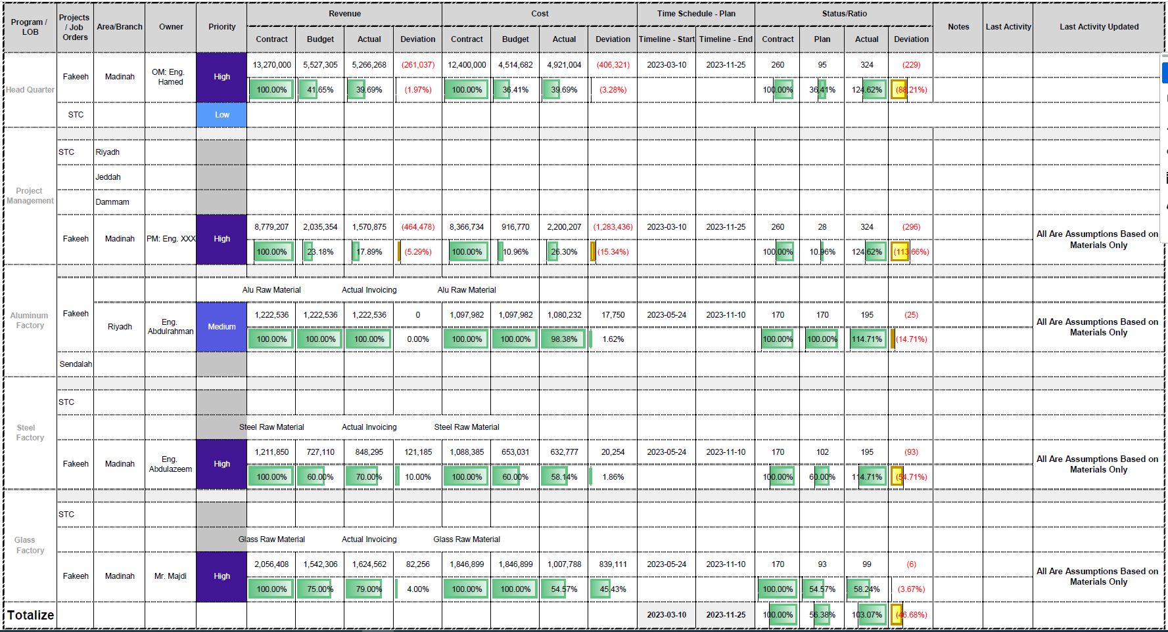
How to Appears in Business Portfolio?
Assumption As Per Quantity
Assumption As Per Quantity
Actual As Per Value
Actual As Per Value

Slide 6
Why we Have to Make all Departments independent & integrated (ERP)
Accurate Measuring of Completion Ratios (Quantities, Values & Time)
Comparing Actual Time Schedule VS Planned (Time Management)
Time Cost (Concept)
Budgeting: Revenue, Project, Production & Alternatives Study
Business Portfolio Overview
Integrate Project Management with Production Management - lifecycle & Plan
Accountability

Slide 7
RoadMap
Action Plan
Project Plan
Production Plan
Budgeting
Project Sales Budget
Outsourcing (Alternatives)
Communications
• Project Lifecycle
• Product Lifecycle
• Tasks & Activities
• Documents Lifecycle
• Privileges & Permissions
Project Cost Budget
Production Cost Budget
Control
• BOQ Control
• Cost Price
• Inventory Turnover
• Alternative Study
• Gaps Analysis &
Recommendations
Purchase Plan
HR Plan
Finance Plan

Slide 8
Goals

Slide 9
Cost Control – Financial Prospective
Achieving the Highest Profit Rate & ROI
Inventory Monitoring (Inventory Turnover Rate & Risks)
Achieving the Best Use of Financial Resources
Performance Monitoring (PKIs)

Slide 10
Quality Control – Customers Prospective
Achieving the Customer Satisfaction
Achieving the Best Use of the Company Resources (4M)

Slide 11
Documents Control – internal processes
Achieving Data Availability (No Lack of Information)
Easing Data-Flow
Documents Keeping

Slide 12
Learning & growth
Professional Reports (Help Decision Makers)
Knowledge Accumulative
Sustainable Development

Slide 13
Requirements

Slide 14
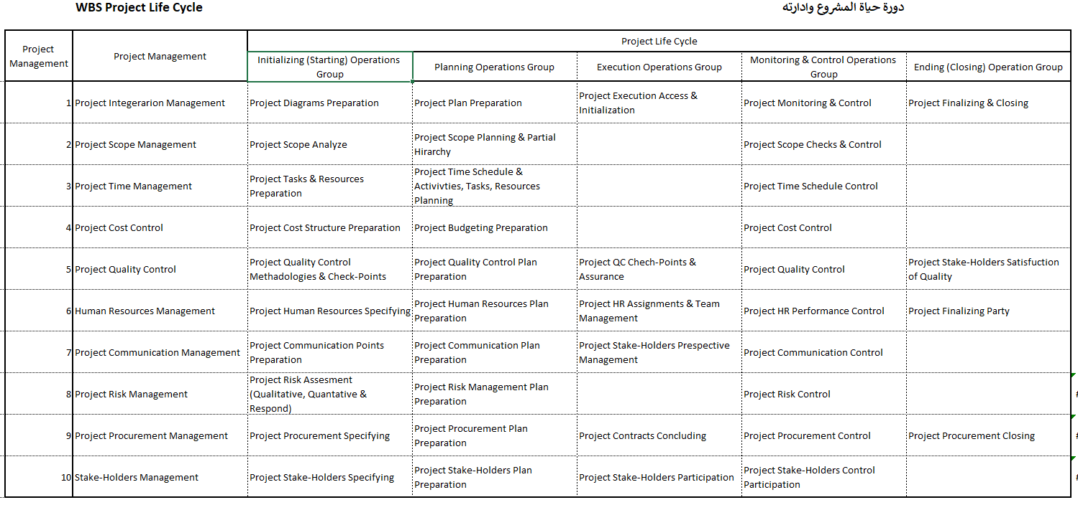
Project Lifecycle- Cost Structure Standardization

Slide 15
Time Schedule (WBS - Red Sea) - Cost Structure Standardization
Activity ID | Activity Name | Original Duration | Start | Finish | Budgeted Total Cost
HC1 | Aluminum & Glazing-Alusystems-BL-R01 |  | 665 | 01-أكتوبر-23 | 26-يوليو-25 | 28,994,056.00
General |  | 665 | 01-أكتوبر-23 | 26-يوليو-25 | 434,910.84
HC1.C27.GEN.CO.0001 | Commencement Date | 0 | 45200 |  | 0
Section / Contract Milestones |  | 549 | 24-يناير-24 | 26-يوليو-25 | 0
Mochup / Benchmark |  | 0 | 24-يناير-24 | 24-يناير-24 | 0
HC1.C27.GEN.BM.0002 | 1.0.1 Completion and acceptance of First in Place Benchmark for Project | 0 |  | 24-Jan-24* | 0
The Mound |  | 238 | 23-مايو-24 | 16-يناير-25 | 0
HC1.C27.L02.MO.0007 | 1.0.7 Manufacture, Deliver and Install all Works - The Mound - Level 02 | 0 |  | 23-May-24* | 0
HC1.C27.L03.MO.0006 | 1.0.8 Manufacture, Deliver and Install all Works - The Mound - Level 03 | 0 |  | 14-Jul-24* | 0
HC1.C27.L04.MO.0005 | 1.0.9 Manufacture, Deliver and Install all Works - The Mound - Level 04 | 0 |  | 18-Jul-24* | 0
HC1.C27.L01.MO.0003 | 1.0.5 Manufacture, Deliver and Install all Works - The Mound - Level 01 | 0 |  | 02-Jan-25* | 0
HC1.C27.L05.MO.0004 | 1.0.10 Manufacture, Deliver and Install all Works - The Mound - Level 05 & 06 | 0 |  | 16-Jan-25* | 0
The Ring |  | 315 | 28-مايو-24 | 08-أبريل-25 | 0
HC1.C27.L00.RI.0011 | 1.0.2 Manufacture, Deliver and Install all Works - The Ring - Level 00 | 0 |  | 28-May-24* | 0
HC1.C27.L01.RI.0010 | 1.0.3 Manufacture, Deliver and Install all Works - The Ring - Level 01 | 0 |  | 13-Jun-24* | 0
HC1.C27.L00.RI.0009 | 1.0.11 Manufacture, Deliver and Install all Works - The Ring - Level 00 (Leave out Area) | 0 |  | 27-Feb-25* | 0
HC1.C27.L01.RI.0008 | 1.0.12 Manufacture, Deliver and Install all Works - The Ring - Level 01 (Leave out Area) | 0 |  | 08-Apr-25* | 0
The Beach |  | 0 | 19-أغسطس-24 | 19-أغسطس-24 | 0
HC1.C27.L00.BE.0012 | 1.0.4 Manufacture, Deliver and Install all Works - The Beach - Level 00 | 0 |  | 19-Aug-24* | 0
The Tail |  | 10 | 01-مايو-25 | 11-مايو-25 | 0
HC1.C27.L01.TA.0014 | 1.0.13 Manufacture, Deliver and Install all Works - The Tail - M03 Zone T1 - Level 01 | 0 |  | 01-May-25* | 0
HC1.C27.L02.TA.0013 | 1.0.14 Manufacture, Deliver and Install all Works - The Tail - M03 Zone T1 - Level 02 | 0 |  | 11-May-25* | 0
Time for Completion |  | 0 | 26-يوليو-25 | 26-يوليو-25 | 0
HC1.C27.GEN.CO.0015 | 1.0.15 Time for Completion for the Whole of the Works | 0 |  | 26-Jul-25* | 0
Key / Control Milestones |  | 473 | 24-يناير-24 | 11-مايو-25 | 0
Mochup / Benchmark |  | 0 | 24-يناير-24 | 24-يناير-24 | 0
HC1.C27.GEN.BM.2882 | 1.2.1 Completion and acceptance of First in Place Benchmark for Project | 0 |  | 24-يناير-24 | 0
The Mound |  | 282 | 09-أبريل-24 | 16-يناير-25 | 0
Level 01 |  | 0 | 02-يناير-25 | 02-يناير-25 | 0
HC1.C27.L01.MO.2883 | 1.2.5 The Mound - Level 01 - Zone M3 (Spa & Fitness) | 0 |  | 02-يناير-25 | 0
Level 02 |  | 44 | 09-أبريل-24 | 23-مايو-24 | 0
HC1.C27.L02.M1.2884 | 1.2.10 The Mound - Level 02 - Zone M1 | 0 |  | 09-أبريل-24 | 0
HC1.C27.L02.M3.2885 | 1.2.12 The Mound - Level 02 - Zone M3 | 0 |  | 24-أبريل-24 | 0

Slide 16
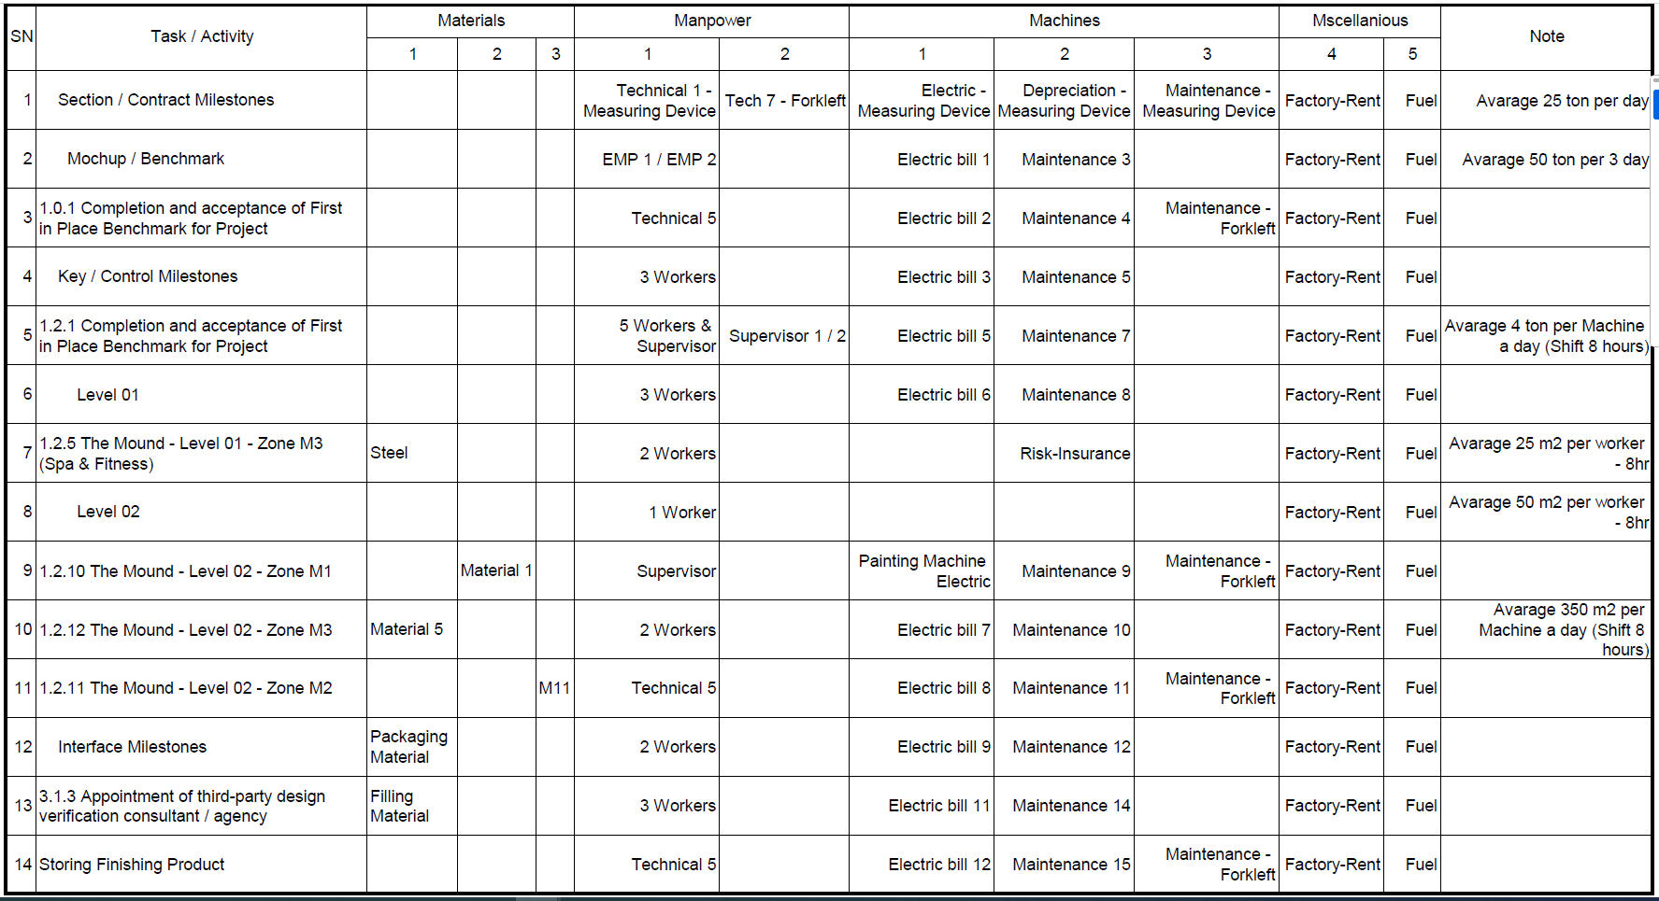
WBS Activity wise - Cost Structure Standardization

Slide 17
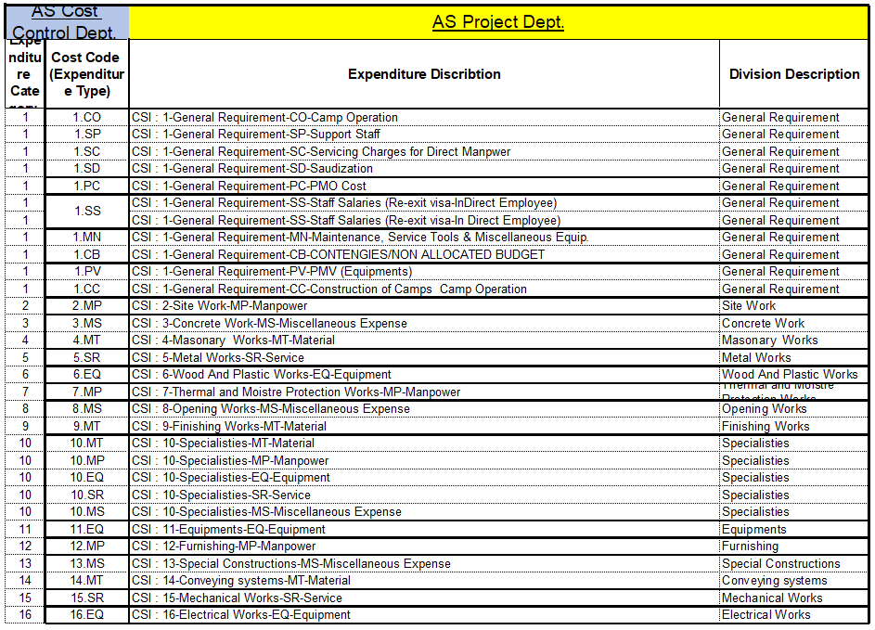
Project Cost Structure Standardization – Project management

Slide 18
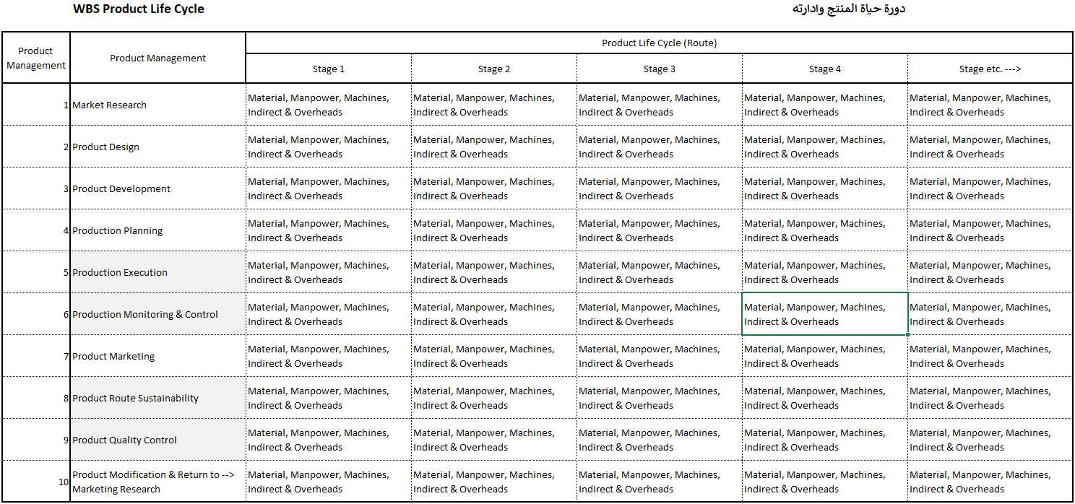
Product Lifecycle (Industrial) - Cost Structure Standardization

Slide 19
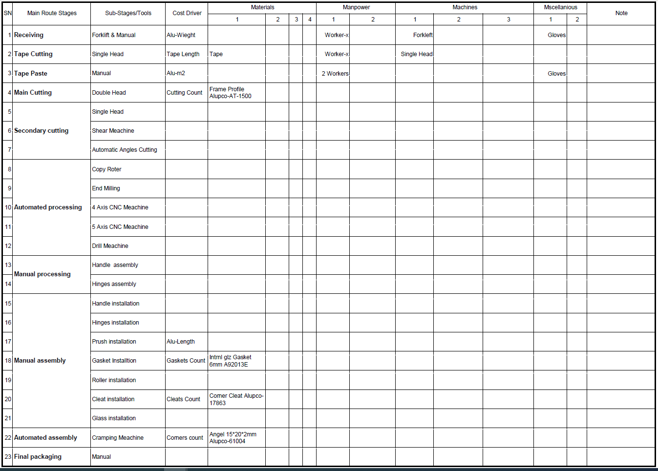
Product (industrial) Costs ABC Analyzing – Cost Driver

Slide 20
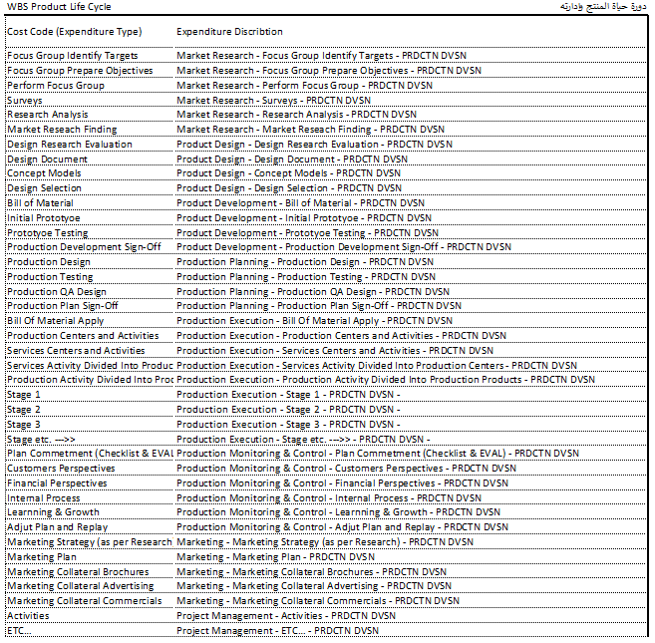
Product (Industrial) Cost Structure Standardization – Production Management

Slide 21
Estimation Budget – before contract
Partial Sales Budget | 10239 – Fakeeh hospital
Partial Cost Budget 10239 – Fakeeh hospital
T-Price | U-Price | QTTY | SPECs | Item Description | Item Code
1,204,773 | 216.37 | 5,568 | Zone A Front elevation Hinged Window Inside curtainwall – ALUPCO 56D Alupco-AT-1500-Length 5100-Hight FOUR SIDED FIXED STR'L GLAZED CURTAIN WALL | Aluminum Frames Delivery & Installation | CW01-W01
3,413,523 | 613 | 5,568 |  | Glass/ACP Delivery | CW01-W01
1,003,977 | 180 | 5,568 |  | Glass Installation | CW01-W01
33,440 | 160 | 209 | ADDITIONAL PRICE FOR CURTAIN WALL FOR OPERABLE PANEL DUE TO ADDITIONAL THERMAL BREAK PROFILES FOR ALUMINUM FRAME, ALUMINUM LEAF AND ACCESSORIES & HARDWARE | Window Delivery | CW01- OPENINGS
100,320 | 480 | 209 |  | Window Delivery & Install | CW01- OPENINGS
212,355 | 148.50 | 1430 | 4MM ALUMINUM COMPOSITE PANEL CLADDING ON ALUPCO ALUMINUM CURTAIN WALL SYSTEM | Aluminum Frames Delivery & Installation | ACP-01(A)
424,710 | 297 | 1430 |  | Aluminum Cladding Delivery & Installation | ACP-01(A)
70,785 | 49.50 | 1430 |  | Aluminum Cladding Delivery | ACP-01(A)
38,458 | 9,861 | 3.9 | SUPPLY , FABRICATION & INSTALLATION FOR EXTERNAL STEEL STRUCTURE SUPORT BEAMS | EXTERNAL STEEL SUPPORT FOR (CW01-CW02 ) | CW01-CW02
6,502,341 |  |  | Total
T-Price | U-Price | QTTY | SPECs | Item Description | Item Code
1,082,007 | 194 | 5,568 | Zone A Front elevation Hinged Window Inside curtainwall – ALUPCO 56D Alupco-AT-1500-Length 5100-Hight FOUR SIDED FIXED STR'L GLAZED CURTAIN WALL | Aluminum Frames Delivery & Installation | CW01-W01
3,065,445 | 551 | 5,568 |  | Glass/ACP Delivery | CW01-W01
900,131 | 162 | 5,568 |  | Glass Installation | CW01-W01
30,033 | 144 | 209 | ADDITIONAL PRICE FOR CURTAIN WALL FOR OPERABLE PANEL DUE TO ADDITIONAL THERMAL BREAK PROFILES FOR ALUMINUM FRAME, ALUMINUM LEAF AND ACCESSORIES & HARDWARE | Window Delivery | CW01- OPENINGS
90,099 | 431 | 209 |  | Window Delivery & Install | CW01- OPENINGS
190,720 | 133 | 1430 | 4MM ALUMINUM COMPOSITE PANEL CLADDING ON ALUPCO ALUMINUM CURTAIN WALL SYSTEM | Aluminum Frames Delivery & Installation | ACP-01(A)
381,440 | 267 | 1430 |  | Aluminum Cladding Delivery & Installation | ACP-01(A)
63,573 | 44 | 1430 |  | Aluminum Cladding Delivery | ACP-01(A)
34,540 | 8,856 | 3.9 | SUPPLY , FABRICATION & INSTALLATION FOR EXTERNAL STEEL STRUCTURE SUPORT BEAMS | EXTERNAL STEEL SUPPORT FOR (CW01-CW02 ) | CW01-CW02
5,837,988 |  |  | Total

Slide 22
Project/Product Budgeting Based on WBS & ABC
Partial Project Budget | 10239 – Fakeeh hospital
Partial Product Budget 10239 – Fakeeh hospital
Activity ID | Activity Name | Original Duration | Start | Finish | Quantity | Budgeted Total Cost
FK1 | ALU-BL-R01 | HC1 | Aluminum & Glazing-Alusystems-BL-R01 | 665 | 01-أكتوبر-23 | 26-يوليو-25 |  | 4,514,682.48
General |  | 214 | 2023-03-10 | 2023-10-10 |  | 434,910.84
FK1.C11.GEN.CO.0001 | Commencement Date |  |  |  |  | -
Section / Contract Milestones |  |  |  |  |  | -
Mobilization |  |  |  |  |  | -
Design, Procurements, Materials Fabrication & Delivery to Site & Installation |  | 210 | 2023-03-10 | 2023-10-06 | 100% | 434,910.84
Materials Submission, .Shop Drawings, Mochup & Submital & Approval |  | 45 | 2023-03-10 | 2023-04-24 | 70% | 304,437.59
FK1.C11.GEN.CO.02 | Mochup & Submital & Approval | 14 | 2023-03-17 | 2023-03-31 | 20% | 86,982.17
FK1.C11.GEN.CO.03 | Procurement | 135 | 2023-04-25 | 2023-09-07 | 25% | 108,727.71
FK1.C11.GEN.CO.04 | Fabrication | 140 | 2023-05-09 | 2023-09-26 | 25% | 108,727.71
Installation |  | 140 | 2023-05-23 | 2023-10-10 | 30% | 130,473.25
المنتج | الكمية المنتجة بالوحدة | مواد مباشرة |  | أجور مباشرة |  | تكاليف تشغيل الآلات |  | تكاليف صناعية أخرى |  | التكلفة الصناعية للوحدة | م عمومية وإدارية |  | متوسط التكلفة للوحدة | اجمالي التكاليف
 |  | للوحدة | الإجمالي | للوحدة | الإجمالي | للوحدة | الإجمالي | للوحدة | الإجمالي |  | للوحدة | الإجمالي
ALUPCO 56 Hinged Widow | 205 | 187.11 | 38,357.98 | 18.47 | 3,785.53 | 45.17 | 9,259.57 | 13.77 | 2,823.50 | 264.52 | 18.52 | 3,795.86 | 283.04 | 58,022.44
 | - | - | - | - | - | - | - | - | - | - | - | - | - | -
 | - | - | - | - | - | - | - | - | - | - | - | - | - | -
 | - | - | - | - | - | - | - | - | - | - | - | - | - | -
Grand Total | 205 | 187.11 | 38,357.98 | 18.47 | 3,785.53 | 45.17 | 9,259.57 | 13.77 | 2,823.50 | 264.52 | 18.52 | 3,795.86 | 283.04 | 58,022.44
ملاحظات: |  | 66% |  | 7% |  | 16% |  | 5% |  | 93% | 7% |  | التكاليف:
 | 1- يوجد انخفاض في معدل المواد المباشرة نظراً لعدم دقة البيانات الواردة من المحطات خاصة |  |  |  |  |  |  |  |  | 179% | 13% |  | الهامش شامل القيمة المضافة:
 | 2- تم تحميل م إدارية وعمومية بنسبة 4% من اجمالي التكاليف يجب ألا تتعدى المصروفات الإدارية 10% من اجمالي التكاليف |  |  |  |  |  |  |  |  |  |  |  | الربح:
 | 3- تم حساب التكاليف للكميات المباعة فعلياً بغض النظر عن الكميات المنتجة لعدم وجود دقة في تقارير الإنتاج |  |  |  |  |  |  |  |  |  |  |  | الربح قيمة:
It Should be per Quantity Material, Manpower, Machines, MSc.

Slide 23

Outsourcing (Alternatives) study
Which one return my money ASAP
Which One Achieves my Dream ROI

Slide 24

ERP System Implementation (Integration)

Slide 25
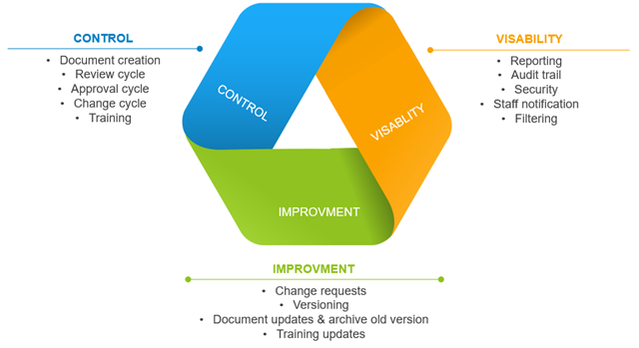
Documents lifecycle & Control (Integration)

Slide 26
The end thanks

